Slide 1
Eppstein’s Algorithm
File
Multiple Shortest Paths Graph Algorithm
April 28th
Gavin Crigger, Tao Groves, Matthew Lucio, Justin Park

Slide 2

File
Multiple Shortest Paths Graph Algorithm
April 28th
Problem statement
Given graph G = (V,E), number k, and vertices S and T, find and return the k unique shortest paths between vertices S and E.
S
3
V₂
2
m = |E|, n = |V|
1
5
V₅
V₇
1
V₁
1
V₄
Naive approach: modified Dijkstra's, visiting each vertex at most k times.
Runtime = O(knlog(kn))
2
6
T
5
2
V₃
V₆
4
5

Slide 3
File
Multiple Shortest Paths Graph Algorithm
April 28th
Why is this problem difficult?
How do these edges differ in priority considering both S and T? How about 3 paths down the line? We must evaluate k times.
Finding the k shortest paths between two terminals, s and t, is difficult - a priority queue alone struggles to consider how each edge impacts the distance between s and t faster than O(knlog(kn)). We cannot simply pop off a new path in log(n) time as is.
How can we reframe our problem to only contain one terminal?
S
3
2
1
5
1
1
2
6
2
T
5
4
5

Slide 4
File
Multiple Shortest Paths Graph Algorithm
April 28th
A solution!
From Eppstein himself, “The main idea of our k shortest paths algorithm, then, is to translate the problem from one with two terminals, s and t, to a problem with only one terminal. One can find paths from s to t simply by finding paths from s to any other vertex and concatenating a shortest path from that vertex to t.”
A reversed graph gives the optimal path and weight from all nodes to terminal T!
S
3
2
1
5
1
1
2
Djikstra’s finds the shortest path from s to all nodes, thus we reverse the graph to find the shortest path from all nodes to t.
6
2
T
5
4
5

Slide 5
File
Multiple Shortest Paths Graph Algorithm
April 28th
2
Indirect paths
Taking me makes your path weight 16 instead of 14!
Let’s find a way to construct a new graph from the input graph such that each edge popped from our min-heap represents the next shortest path - every pop is a path! This can only be done with one terminal and the weights/paths for each node to T.
Eppstein’s proper constructs this graph in O(m + nlog(n)) time, and the following k pops run in O(k) time, giving a total runtime of O(m + nlog(n) + k).
Key concept: sidetrack edges
Given the optimal path from S to E, sidetrack edges represent deviations from the optimal path. They are weighted by how much the total path weight increases from the optimal path by taking that edge.

Slide 6
File
Multiple Shortest Paths Graph Algorithm
April 28th
Sidetrack graph example
Sidetrack graph G’
Edge weight: sidetrack(u, v, w) = w + d_{v} - d_{u}, where d_{a} represents the weight of the optimal path from vertex a to E.
S
G = (V, E)
E
4
(V₃, S, 4)
V₃
3
2
(V₂, V₃, 3)
5
(S, V₁, 1)
V₂
V₃
3
V₁
3
V₁
(V₁, V₁, 3)
2
(V₂, V₃, 3)
1
S
V₂
All sidetrack edges on the path from a node U to end node E are considered directly connected to U.

Slide 7
File
Multiple Shortest Paths Graph Algorithm
April 28th
Reconstructing paths from single sidetrack edges
P_{v3}
T
4
V₃
The use of implicit path representations is key to Eppstein’s algorithm achieving its quick runtime - each popped sidetrack edge can be used with precalculated values to find the explicit path.
We use Dijkstra's on a reversed G to set up the d_{u} values and optimal paths p_{u} for each vertex. Thus, we can take sidetrack edge (u, v, w) and paths p_{s-u}, p_{v} to construct path p_{s-u} + (u, v, w) to p_{v}.
3
2
5
V₂
3
V₁
3
2
P_{s-v2}
1
S
Notes:
MATTHEW - re-iterate BRIEFLY that indirect representations are the only way to speed up runtime (1 pop 1 path), show how to go back to a full path representation quickly using our precomputed values. Be sure to mention that reverse Djikstra’s is what gives us the optimal path/weight for each vertex (essential for rebuilding path)

Slide 8
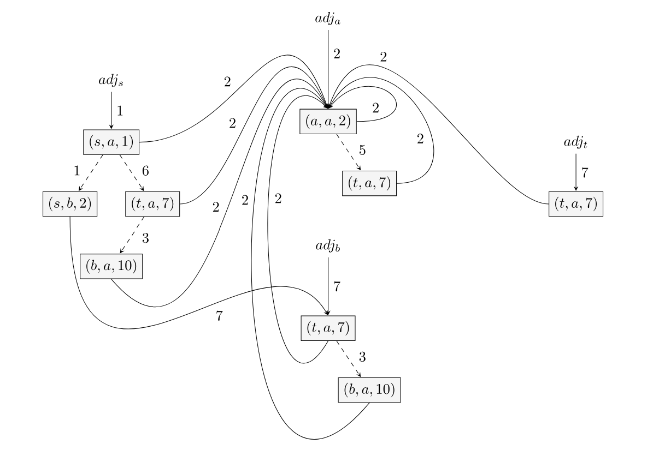
File
Multiple Shortest Paths Graph Algorithm
April 28th
Overall approach
Persistence omitted for simplicity!
1) Construct a graph that stores sidetrack edges as nodes and edge traversals as paths with sidetrack weights as path weights.
Built around using persistent heaps for each adjacency list adj_{u} in our graph, with path traversals connecting heaps.
2) Push the start node and its optimal path weight to a heap, then loop k times: popping from the heap, recording the implicit path representation, and pushing all neighboring sidetrack path weights and their vertices.
Notes:
GAVIN

Slide 9
File
Multiple Shortest Paths Graph Algorithm
April 28th
Graph construction
S
3
2
1
5
1
1
Eppstein’s algorithm (G = (V, E), s, t, k)
# graph construction
1 build reverse graph G_{r} from G
2 run Dijkstra's on G_{r}, s, t to find d_{u}, p_{u} for all vertices
3 construct shortest path tree T from p_{u}
2
6
2
T
5
4
5
Reversed Djikstra’s from t gives us d_{u} and p_{u} for all vertices.
S
3
2
1
5
1
1
2
6
2
T
5
4
5

Slide 10
File
Multiple Shortest Paths Graph Algorithm
April 28th
Heap edges are dashed, one heap per vertex (representing vertex’s sidetrack adjacency list)
Graph construction
H_{s}
2
(S, V₁, 2)
Eppstein’s algorithm (G = (V, E), s, t, k)
# graph construction
1 build reverse graph G_{r} from G
2 run Dijkstra's on G_{r}, s, t to find d_{u}, p_{u} for all vertices
3 construct shortest path tree T from p_{u}
4 create min-heap H_{u} of sidetrack edges for all vertices (faster adjacency lists)
5 create result set R_{a} = d_{s}
6 create overarching min-heap Q_{p} initially with (d_{s}, H_{s})
1
2
(V₁, V₁, 3)
(V₂, V₃, 4)
… ∀ v ∈ V
3
9
H_{u}
1
Solid lines connect heaps, weighted by the destination sidetrack edge.
(U, V₆, 1)
1
8
(V_{4,} V₁, 2)
(V₃, V₈, 9)

Slide 11
File
Multiple Shortest Paths Graph Algorithm
April 28th
Our next optimal path has weight d_{s} + 2. When we push children, we push our cumulative path weight with them (accumulating sidetrack weight).
K-pop algorithm
Eppstein’s algorithm (G = (V, E), s, t, k)
# k-pop algorithm
7 while len(R_{a}) < k and Q_{p} is not empty
8 pop total cost, node from Q_{p}
9 add cost to R_{a}
10 push node’s outgoing edges to Q_{p} with cumulative cost + sidetrack weight
11 return R_{a}
Q_{p}
H_{s}
Found the next optimal path! Push this node’s children and re-loop.
2
(S, V₁, 2)
1
2
(V₁, V₁, 3)
(V₂, V₃, 4)
… repeat k times

Slide 12
File
Multiple Shortest Paths Graph Algorithm
April 28th
Graph creation
Overall pseudocode
G, s, t, k
T
G
s, t
Eppstein’s algorithm (G = (V, E), s, t, k)
# graph construction
1 build reverse graph G_{r} from G
2 run Dijkstra's on G_{r}, s, t to find d_{u}, p_{u} for all vertices
3 construct shortest path tree T from p_{u}
4 create min-heap H_{u} of sidetrack edges for all vertices
5 create result set R_{a} = d_{s}
6 create overarching min-heap Q_{p} initially with (d_{s}, H_{s})
# k-pop algorithm
7 while len(R_{a}) < k and Q_{p} is not empty
8 pop total cost, node from Q_{p}
9 add cost to R_{a}
10 push node’s outgoing edges to Q_{p}
11 return R_{a}
G_{r}
Djikstra’s
d_{u}, p_{u} ∀ u ⋹ V
return!
cost
R_{a}
d_{u}, p_{u}
outgoing edges
Q_{p}
H_{u}
cost, node
K-pop algorithm

Slide 13
File
Multiple Shortest Paths Graph Algorithm
April 28th
Runtime analysis 1
Eppstein’s algorithm (G = (V, E), s, t, k)
# graph construction
1 build reverse graph G_{r} from G
2 run Dijkstra's on G_{r}, s, t to find d_{u}, p_{u} for all vertices
3 construct shortest path tree T from p_{u}
1: Graph reversal / Dijkstra’s
O(m)
O(m + nlog(n))
O(n)
O(m + nlog(n))
Follows a well-documented, optimized Djikstra’s algorithm

Slide 14
File
Multiple Shortest Paths Graph Algorithm
April 28th
Runtime analysis 2
Eppstein’s algorithm (G = (V, E), s, t, k)
4 create min-heap H_{u} of sidetrack edges for all vertices
5 create result set R_{a} = d_{s}
6 create overarching min-heap Q_{p} initially with (d_{s}, H_{s})
2: G’ construction
O(m + nlog(n))
O(1)
O(1)
O(m + nlog(n))
With persistent heaps, all edges are visited once and all vertices have logarithmic inserts

Slide 15
File
Multiple Shortest Paths Graph Algorithm
April 28th
Runtime analysis 3
Overall: O(m + nlog(n) + k)
Eppstein’s algorithm (G = (V, E), s, t, k)
# k-pop algorithm
7 while len(R_{a}) < k and Q_{p} is not empty
8 pop total cost, node from Q_{p}
9 add cost to R_{a}
10 push node’s outgoing edges to Q_{p}
11 return R_{a}
3: k-pop algorithm
O(k)
O(1) (with persistence techniques)
O(k)
We loop through a constant time algorithm until we reach k total paths accumulated

Slide 16
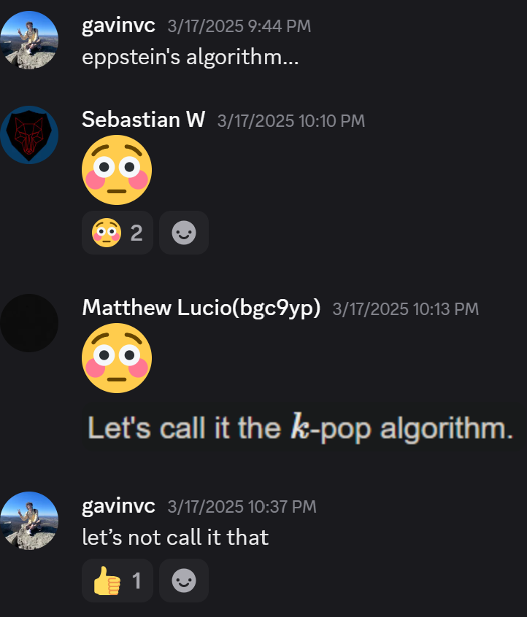
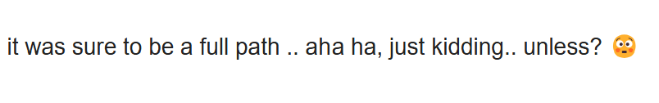
File
Multiple Shortest Paths Graph Algorithm
April 28th
Thank you!

Slide 17


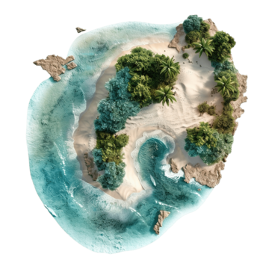
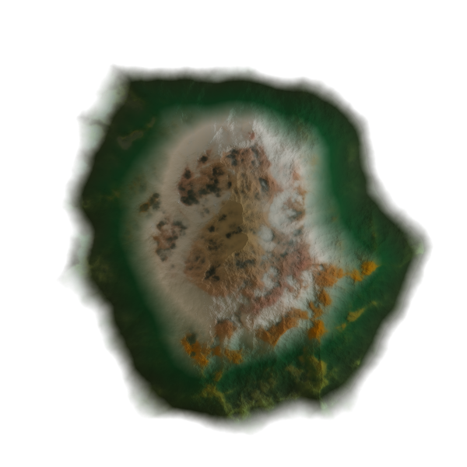
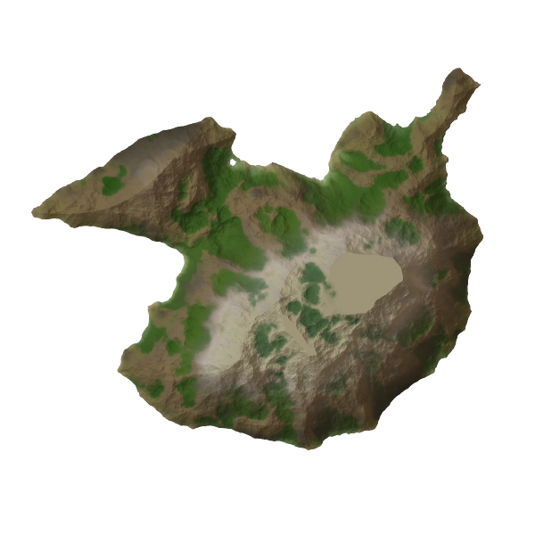



File
Multiple Shortest Paths Graph Algorithm
April 28th
Motivation (bonus slide)
Need to generate many different paths to the same endpoint
Paths may share some edges
Speed is essential
3
V₂
2
1
5
V₅
V₇
1
V₁
1
V₄
2
6
E
5
2
V₃
V₆
4
5

